Slide 1
Rock Paper Scissors An NFC based game
Juilee Chitre Meghambari Khavnekar Niharika Maheshwari Saylee Chitre Vidhya Suresh

Slide 2
Introduction
Near Field Communication
GemaTouch patent of NFC tags
Requirements (tag,beam,db)
Prototype (rps)
Task flow
Demo
Additional functionality

Slide 3
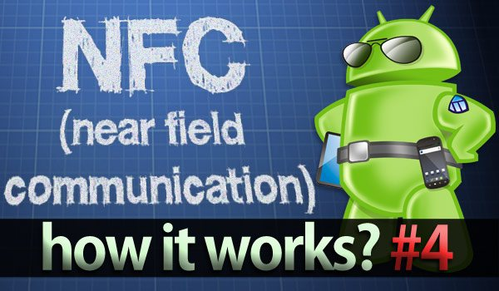
Near Field Communication
short-range wireless technology
typically requiring a distance of 4cm or less to initiate a connection
allows you to share small payloads of data between an NFC tag and an Android-powered device, or between two Android-powered devices.
the two major uses cases when working with NDEF data and Android:
Reading NDEF data from an NFC tag
Beaming NDEF messages from one device to another with Android Beam
Notes:
Near Field Communication (NFC) is a set of short-range wireless technologies, typically requiring a distance of 4cm or less to initiate a connection. NFC allows you to share small payloads of data between an NFC tag and an Android-powered device, or between two Android-powered devices.
There are two major uses cases when working with NDEF data and Android:
Reading NDEF data from an NFC tag
Beaming NDEF messages from one device to another with Android Beam™

Slide 4

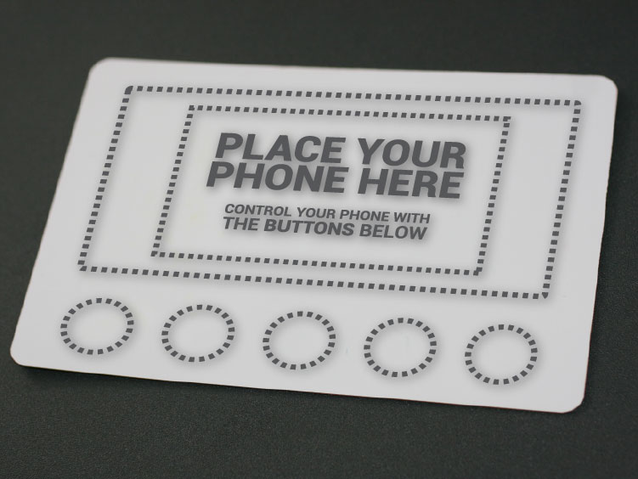
Our technology
turn any printable surface into a touch interface
gives mobile consumers instant access to and control of a digital ecosystem of mobile apps, websites and brand-customized marketing content
E.g.: play a video game through a magazine, get product information directly from an in-store display, or receive coupons from a product's packaging.
Notes:
Our technology
Through our patented NFC infrastructure we turn any printable surface into a touch interface; giving mobile consumers instant access to and control of a digital ecosystem of mobile apps, websites and brand-customized marketing content.
Just imagine being able to play a video game through a magazine, get product information directly from an in-store display, or receive coupons from a product's packaging.
Our tags
We have a proprietary Near Field Communication (NFC) tag design that we can embed into nearly any printable surface from displays, tickets, and even packaging. Our NFC tags are passive, meaning they don't have batteries making it a cost effective solution.
By embedding our tags into a printed media form we can 'program' that print to communicate with your phone, triggered by a user's touch. All of which can be tracked to provide brand feedback and better user experiences. No more cameras, texting, typing or pairing. The integration of physical and digital is easier, more personal and more memorable than ever before.

Slide 5
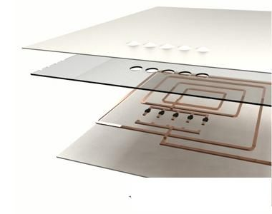
Our tags
proprietary NFC tag design that can be embedded into any printable surface from displays, tickets, and even packaging
tags are passive
cost effective solution
tags can be programmed to communicate with your phone, triggered by a user's touch
this can be tracked to provide brand feedback and better user experiences.
Notes:
Our technology
Through our patented NFC infrastructure we turn any printable surface into a touch interface; giving mobile consumers instant access to and control of a digital ecosystem of mobile apps, websites and brand-customized marketing content.
Just imagine being able to play a video game through a magazine, get product information directly from an in-store display, or receive coupons from a product's packaging.
Our tags
We have a proprietary Near Field Communication (NFC) tag design that we can embed into nearly any printable surface from displays, tickets, and even packaging. Our NFC tags are passive, meaning they don't have batteries making it a cost effective solution.
By embedding our tags into a printed media form we can 'program' that print to communicate with your phone, triggered by a user's touch. All of which can be tracked to provide brand feedback and better user experiences. No more cameras, texting, typing or pairing. The integration of physical and digital is easier, more personal and more memorable than ever before.

Slide 6
Modules
NFC Tag Reading
NFC enabled Beaming
Database interaction

Slide 7
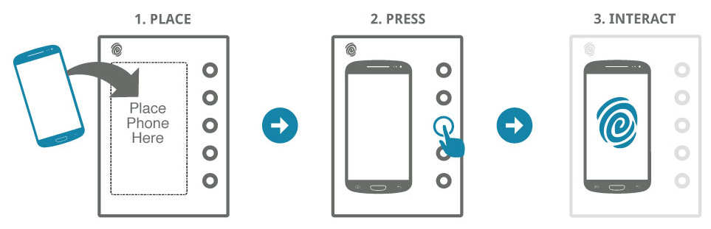
Task flow

Slide 8
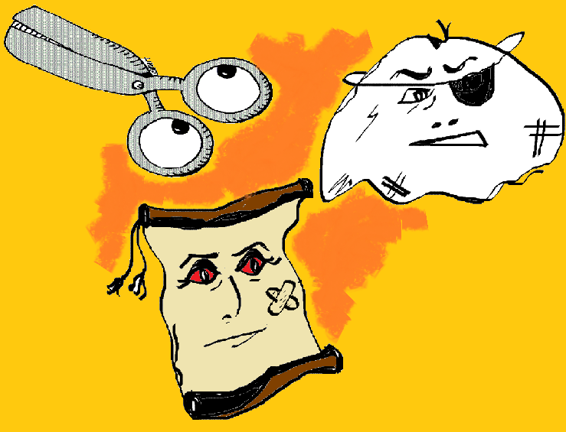

Demo

Slide 9
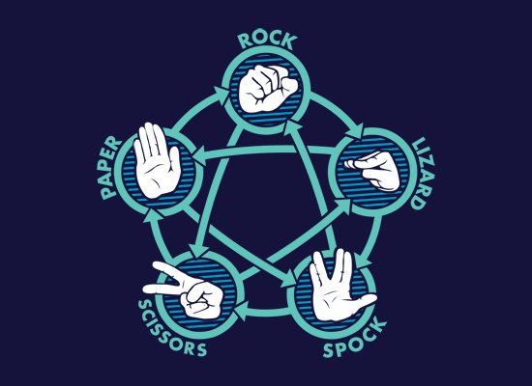
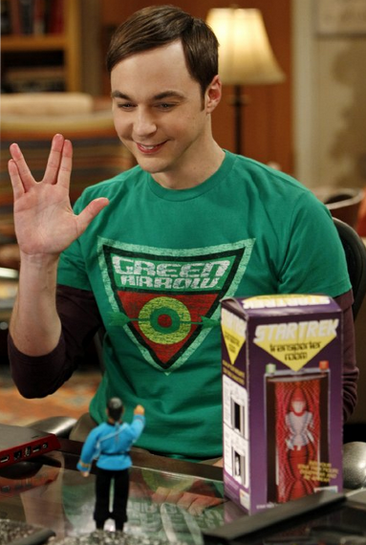
Additional functionality
Notes:
Multi player
Multi culture- eg Japan
Different form of RPS

Slide 10

Thank you
Notes:
Credits-
Brent Fagg
Prof. Watson
Kalpesh Padia
Images-
www.gematouch.com

